Slide 1

General Knowledge round
by The Joel Family

Slide 2

Section 1:
Art and Literature

Slide 3

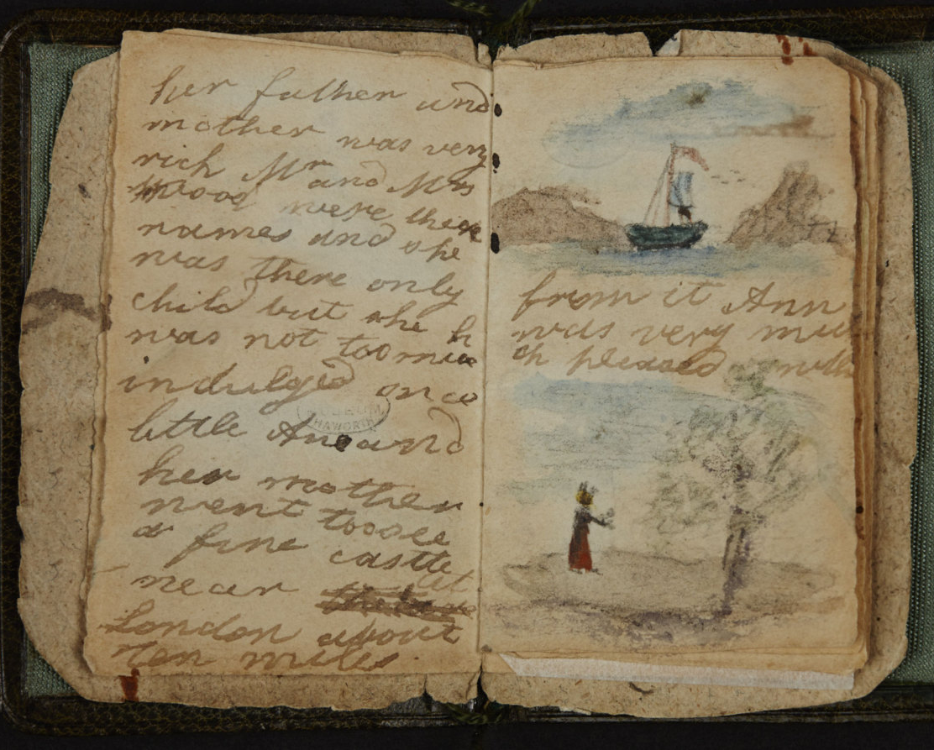
Question 1
As children, which literary family wrote stories set in the fictional worlds of Angria and Gondal?

Slide 4
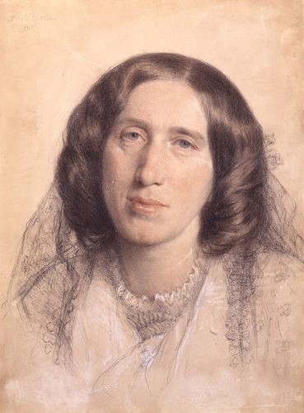
Question 2
To mark the anniversary of the Women’s Prize for Fiction, George Eliot’s work Middlemarch was recently re-released under her real name.
What was it?

Slide 5
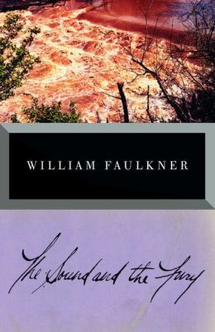
Question 3
William Faulkner’s novel The Sound and the Fury takes its name from lines in which Shakespeare play?

Slide 6
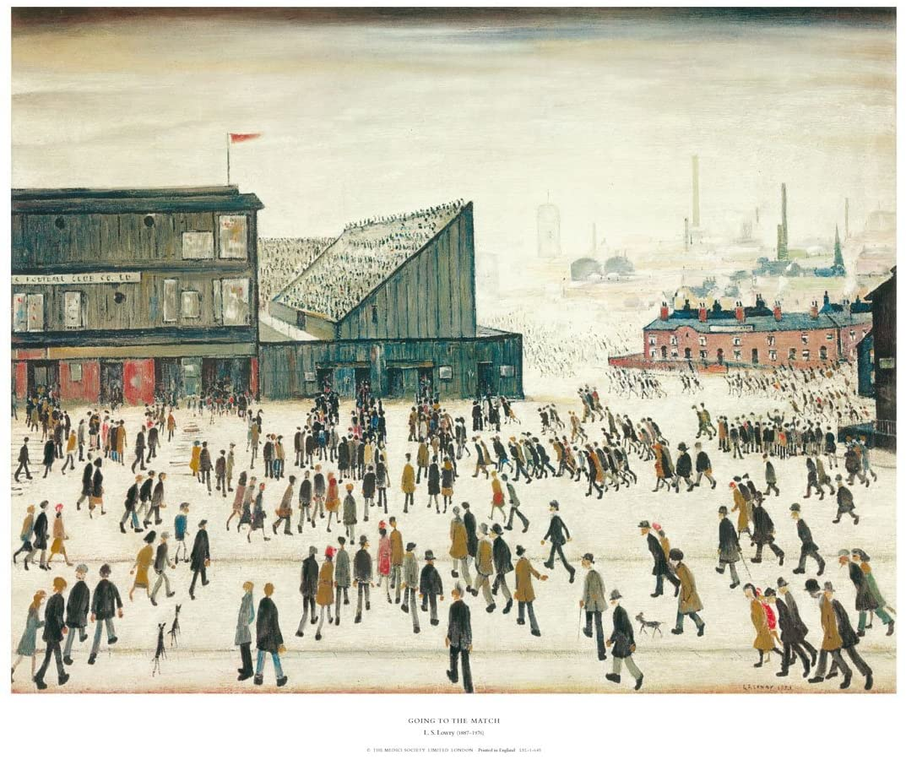
Question 4
LS Lowry’s painting Going to the Match (1953) depicts supporters arriving at which northern football ground?

Slide 7

Section 2:
ENTERTAINMENT

Slide 8
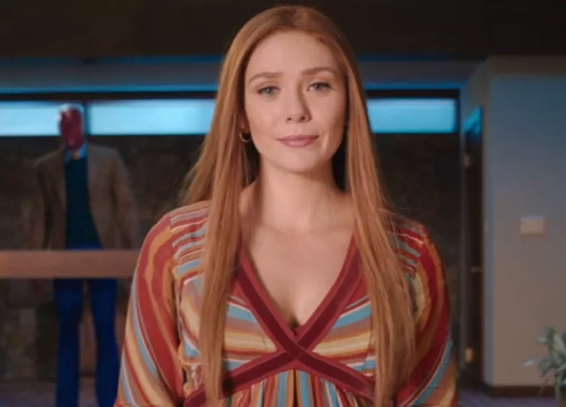
Question 5
Elizabeth Olsen, currently starring in Marvel’s WandaVision, is the younger sister of which twin sister duo, who were a household name in the late 90s and early 2000s?

Slide 9
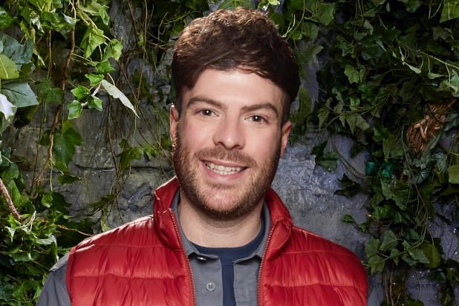
Question 6
Where did Radio One’s Jordan North say was his “happy place” on I’m A Celebrity…Get Me Out Of Here?

Slide 10
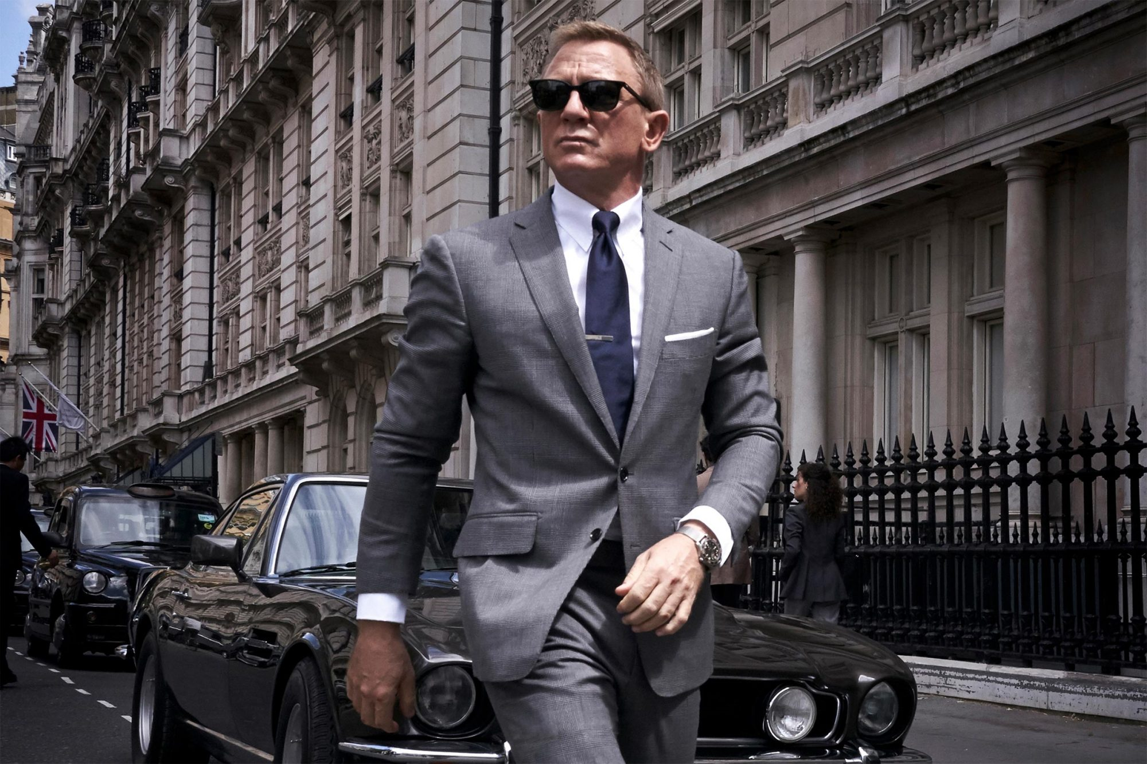
Question 7
What is the name of the James Bond film that was delayed twice in 2020 due to the pandemic?

Slide 11
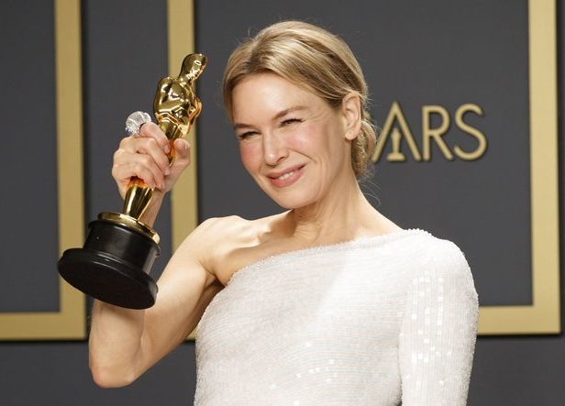
Question 8
In 2020, Renée Zellweger won the best actress Oscar for her portrayal of which legendary performer?

Slide 12
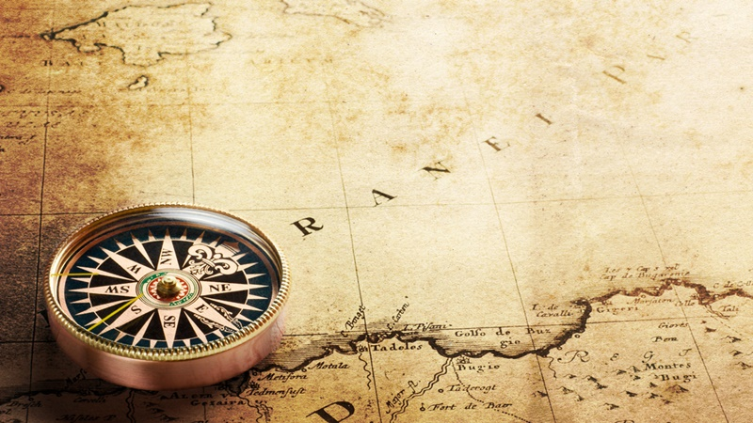
Section 3:
HISTORY &
GEOGRAPHY

Slide 13
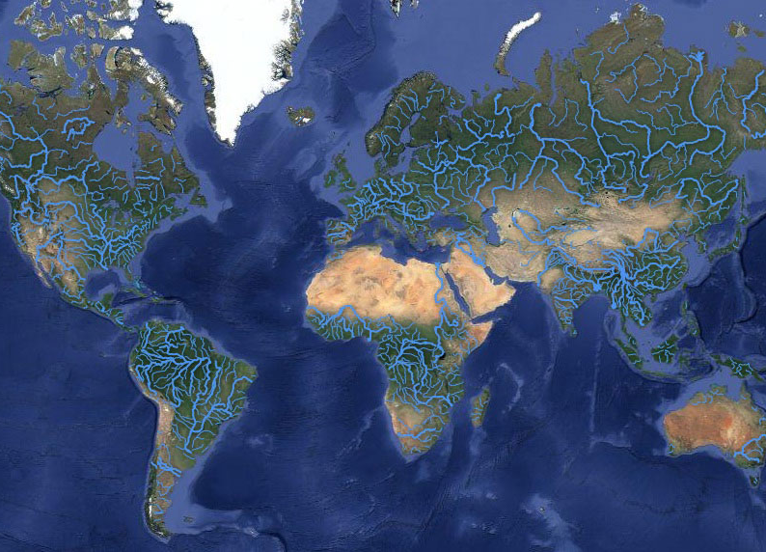
Question 9
Which river passes through the most countries?

Slide 14
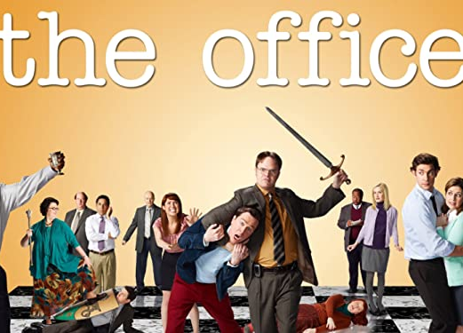
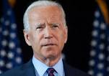
Question 10
Which city in Pennsylvania is both the birthplace of Joe Biden and the setting for the US version of The Office?

Slide 15
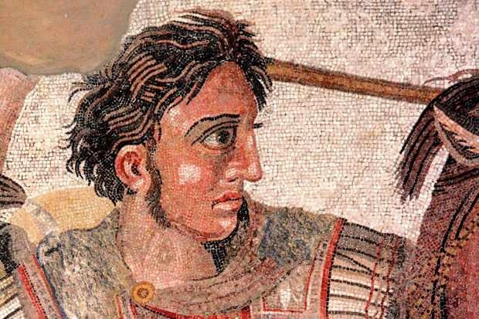
Question 11
In which city did Alexander the Great die?

Slide 16
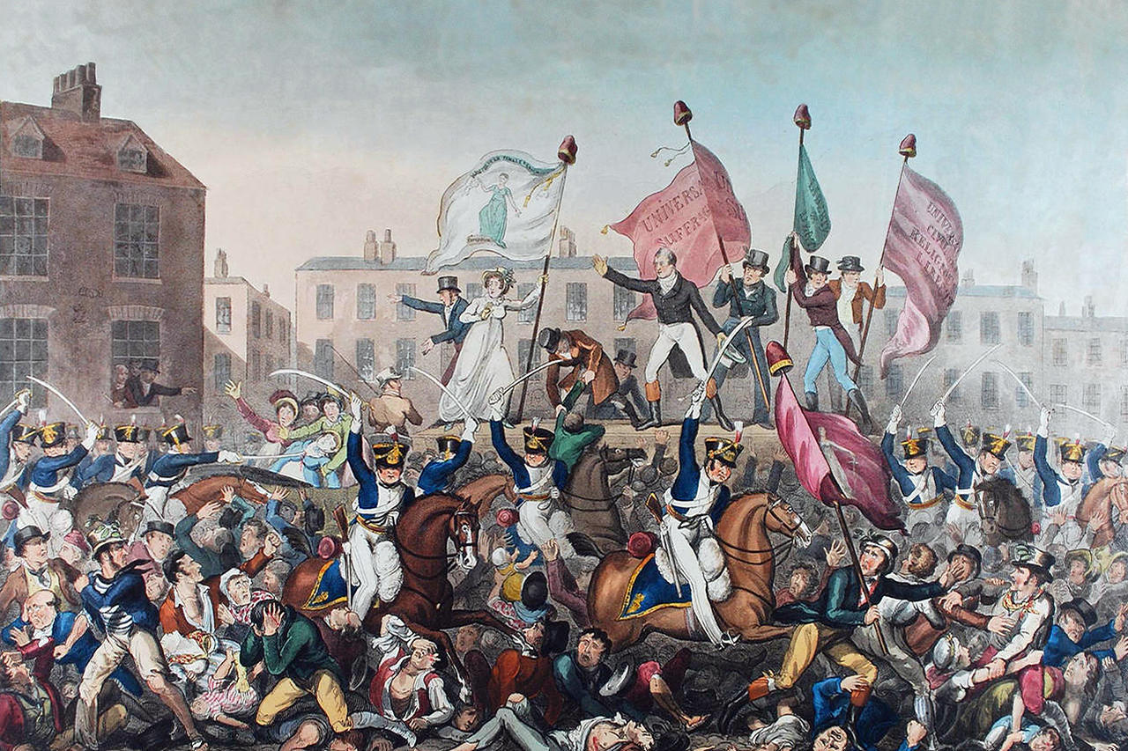
Question 12
In 1819, eighteen people were killed and hundreds injured when cavalry charged into a crowd of peaceful protestors in St. Peter’s Field, Manchester.
What did this event become known as?

Slide 17
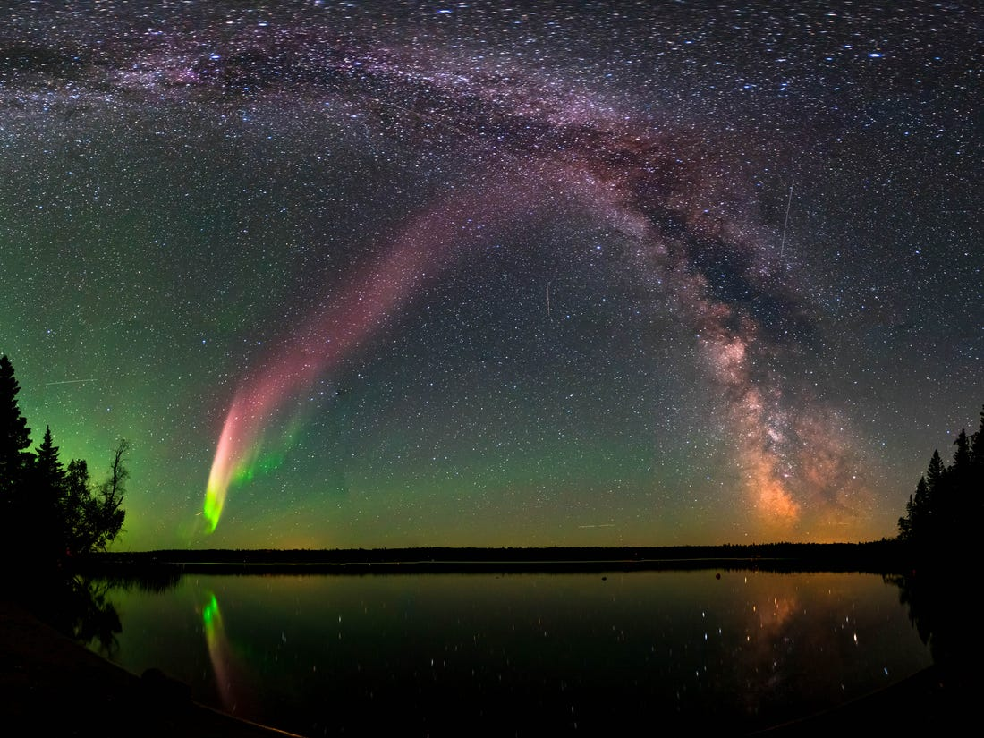
Section 4:
SCIENCE
& NATURE

Slide 18
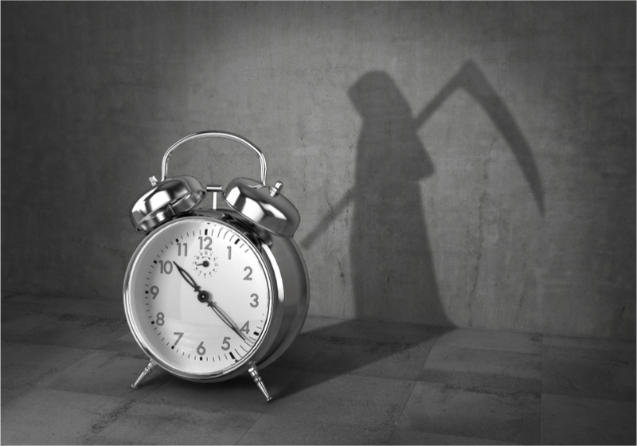
Question 13
True or False:
The average human lives for more than one million hours?

Slide 19
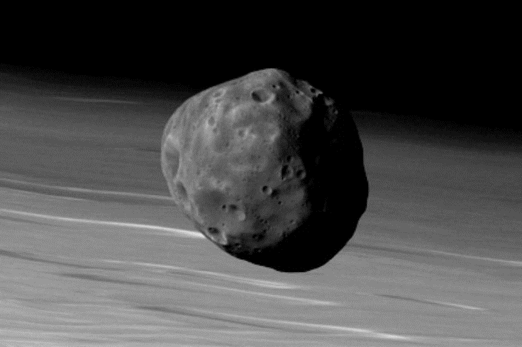
Question 14
Phobos is a moon of which planet?

Slide 20
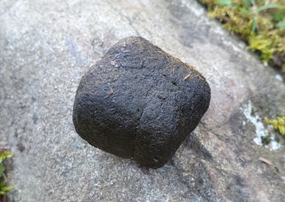
Question 15
Which Australian marsupial is the only animal in the world known to produce cube-shaped poo?

Slide 21
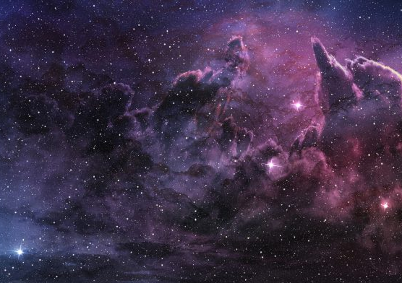
Question 16
What is the most abundant element in the universe?

Slide 22
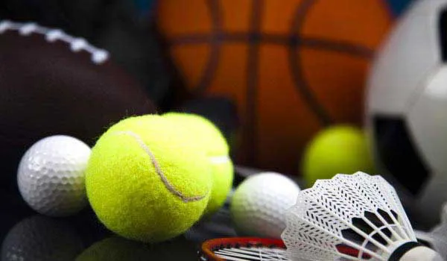
Section 5:
SPORT

Slide 23
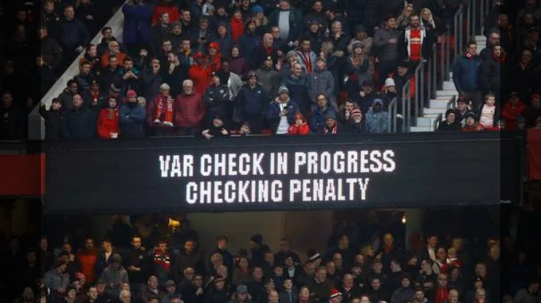
Question 17
In football, what does VAR stand for?

Slide 24
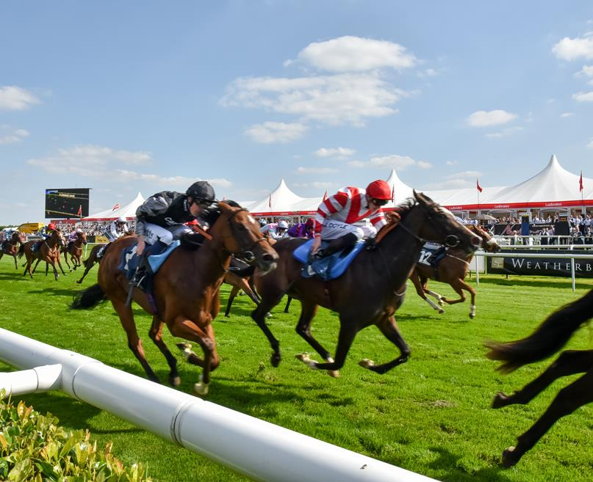
Question 18
In horse racing the five most prestigious races of the flat season are known as The Classics. The 1000 and 2000 Guineas, the Derby and the Oaks are four of them. What is the other?

Slide 25
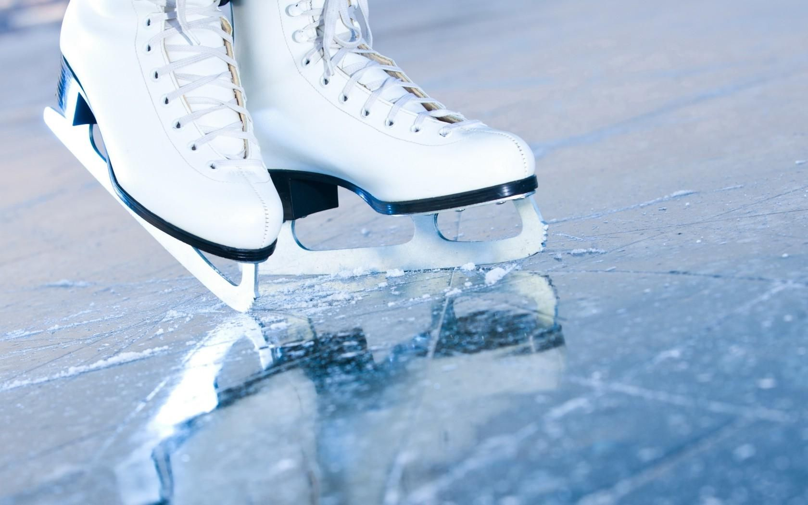
Question 19
In 1994, who was banned for life from the U.S. Figure Skating Association after pleading guilty to involvement in the attack on fellow skater Nancy Kerrigan?

Slide 26
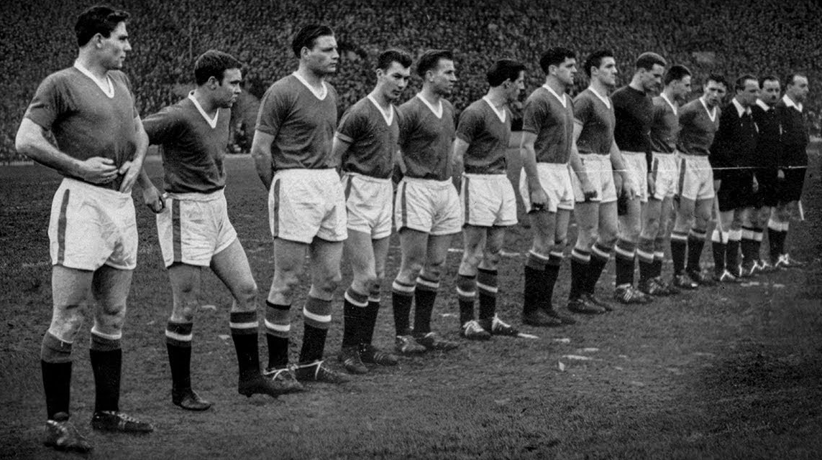
Question 20
Today (February 6th)is the anniversary of the Munich air disaster. United were travelling back from a European Cup game when the tragedy occurred.
Which team had they played?

Slide 27
ANSWERS

Slide 28
Question 1
As children, which literary family wrote stories set in the fictional worlds of Angria and Gondal?
The Brontës

Slide 29
Question 2
To mark the anniversary of the Women’s Prize for Fiction, George Eliot’s work Middlemarch was recently re-released under her real name.
What was it?
Mary Ann Evans

Slide 30
Question 3
William Faulkner’s novel The Sound and the Fury takes its name from lines in which Shakespeare play?
Macbeth

Slide 31
Question 4
LS Lowry’s painting Going to the Match (1953) depicts supporters arriving at which northern football ground?
Burnden Park (Bolton)

Slide 32
Question 5
Elizabeth Olsen, currently starring in Marvel’s WandaVision, is the younger sister of which twin sister duo, who were a household name in the late 90s and early 2000s?
Mary-Kate and Ashley

Slide 33
Question 6
Where did Radio One’s Jordan North say was his “happy place” on I’m A Celebrity…Get Me Out Of Here?
Turf Moor

Slide 34
Question 7
What is the name of the James Bond film that was delayed twice in 2020 due to the pandemic?
No Time To Die

Slide 35
Question 8
In 2020, Renée Zellweger won the best actress Oscar for her portrayal of which legendary performer?
Judy Garland

Slide 36
Question 9
Which river passes through the most countries?
The Danube

Slide 37
Question 10
Which city in Pennsylvania is both the birthplace of Joe Biden and the setting for the US version of The Office?
Scranton

Slide 38
Question 11
In which city did Alexander the Great die?
Babylon

Slide 39
Question 12
In 1819, eighteen people were killed and hundreds injured when cavalry charged into a crowd of peaceful protestors in St. Peter’s Field, Manchester.
What did this event become known as?
The Peterloo Massacre

Slide 40
Question 13
True or False:
The average human lives for more than one million hours?
False

Slide 41
Question 14
Phobos is a moon of which planet?
Mars

Slide 42
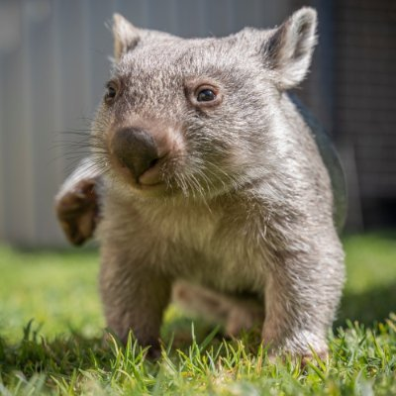
Question 15
Which Australian marsupial is the only animal in the world known to produce cube-shaped poo?
Wombat

Slide 43
Question 16
What is the most abundant element in the universe?
Hydrogen

Slide 44
Question 17
In football, what does VAR stand for?
Video Assistant Referee

Slide 45
Question 18
In horse racing the five most prestigious races of the flat season are known as The Classics. The 1000 and 2000 Guineas, the Derby and the Oaks are four of them. What is the other?
The St. Leger

Slide 46
Question 19
In 1994, who was banned for life from the U.S. Figure Skating Association after pleading guilty to involvement in the attack on rival skater Nancy Kerrigan?
Tonya Harding

Slide 47
Question 20
Today (February 6th)is the anniversary of the Munich air disaster. United were travelling back from a European Cup game when the tragedy occurred.
Which team had they played?
Red Star Belgrade

